Slide 1

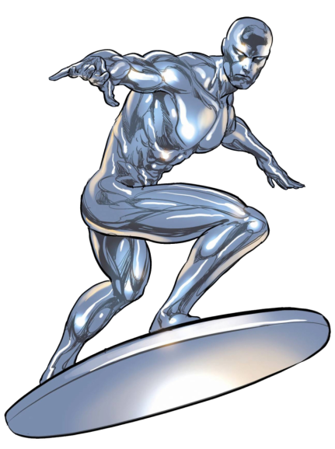
Silver Surfer

Slide 2
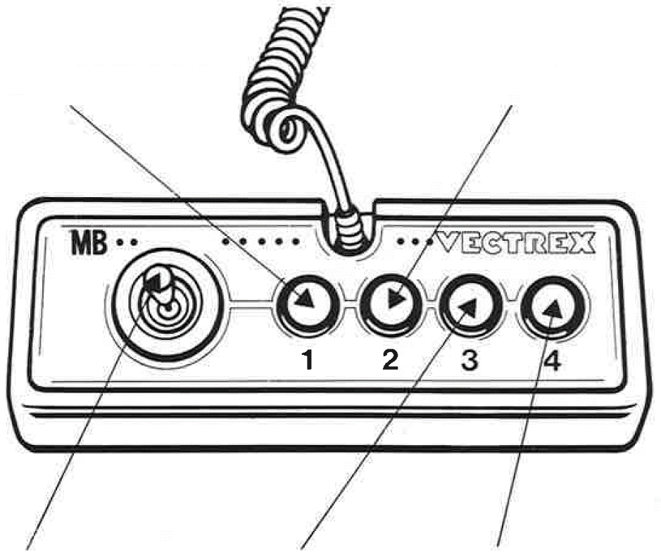
Silver Surfer
GAME CONTROLS
Silver Surfer is designed to be played with the built-in control panel only. The functions of the controls are:
Button 1
Change jump button
Button 2
Change World
Joystick UP
Jump (if selected)
Button 3
Boost
Button 4
Jump (if selected)

Slide 3
HOW TO PLAY
PLAYER SELECTION
There is only one player. No selection needed.
OPTION SELECTION
Through the option menu, the jump button can be selected with the press of button 1. The currently selected jump button is displayed in the middle. Same goes for the world selection. The moon world has less gravity therefore the silver surfer jumps higher and falls less fast. Press button 4 to advance.
GAME PLAY
Silver Surfer is a clone of the popular Flappy Bird game. Silver Surfer jumps vertically with the press of a single button.
With the boost jump Silver Surfer can jump even higher. Be careful, he’s exhausted after a boost jump.
Navigate through the incoming obstacles and don't get hit!
WHATEVER ELSE IS IMPORTANT
The game features several levels which are randomized at the start.

Slide 4
SCORING
Points are awarded for achieving the following:
The player achieves a point for every obstacle overcome.
HIGH SCORE MEMORY
As long as your machine is on, with the game cartridge in place, the highest score is retained. To see this score, press the Reset button. When the machine is turned off and the cartridge removed, the score is lost.
RESTARTING THE GAME
To restart a completed game with the same number of players and the same game option, press any of the four buttons once the game is over. If you wish to restart the game before it is completed or change the number of players or the game option, press the Reset button.

Slide 5
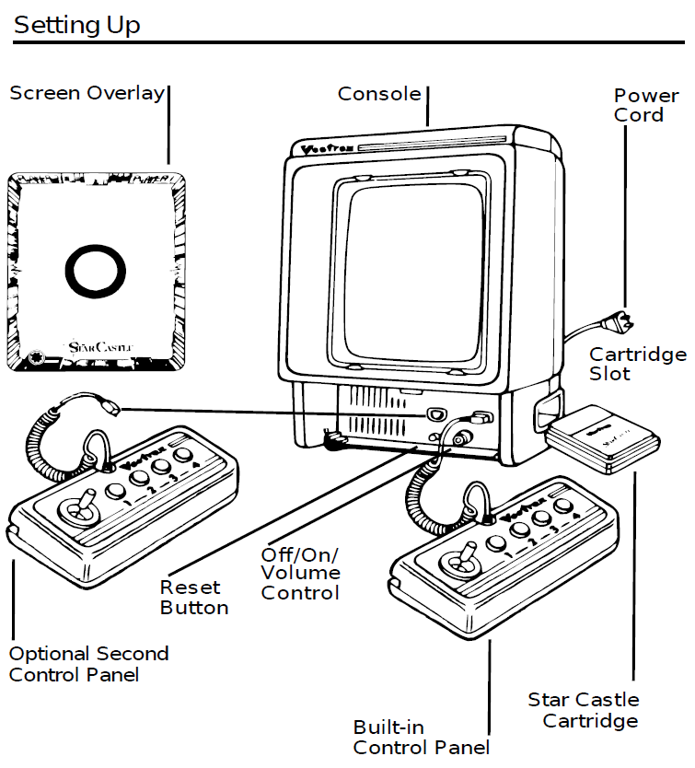
SETTING UP
CREDITS
This game was developed by Marc Retzlaff and programmed in C and MC6809 assembly language. It is the outcome of a student project which was part of the elective course “Advanced hardware-oriented C and Assembly Language Programming” at Pforzheim University, Germany, in spring term 2020, supervised and tutored by Prof. Dr. rer. nat. Peer Johannsen.

Slide 6


